Slide 1
House Prices: Advanced Regression Techniques
A Kaggle Competition
Hemshree Mangrola

Slide 2
Introduction
House prices change with a lot of aspects, it’s not only the house that plays a role in the price of the house but there are various other factors that influences the prices.
The factors of the house includes the amenities, the construction, the number of rooms, the area and various other factors.
The other factors affecting the sale price include the location of the house, the city/town and state.
There are economic conditions of the state and the country which influences the prices of house as well!

Slide 3
Stats!

Slide 4
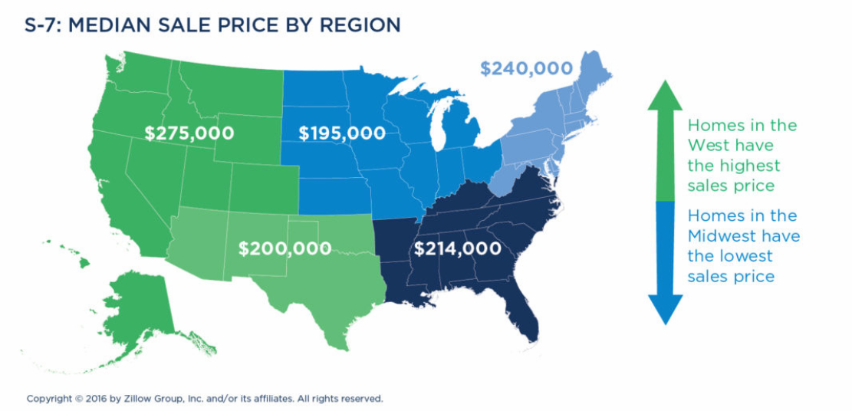

Slide 5
USA experienced recession in the year of 2008, we will check the overall prices in Ames to see whether the prices did actually change over that period! Image from: Data Analysis on the dataset in tableau

Slide 6
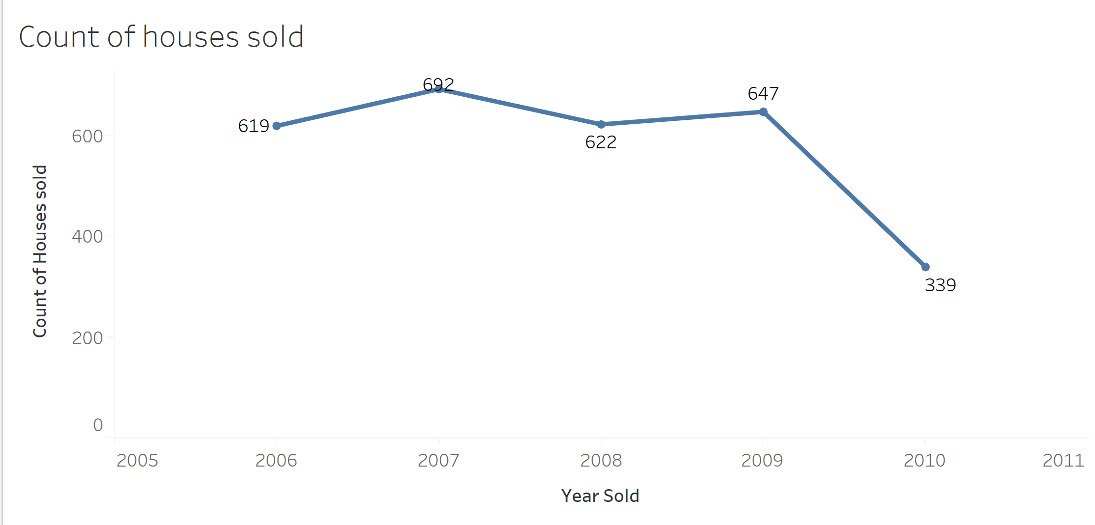

Slide 7
Factors in the house that influence the price of the house Reference: Zillow Analysis 2016

Slide 8
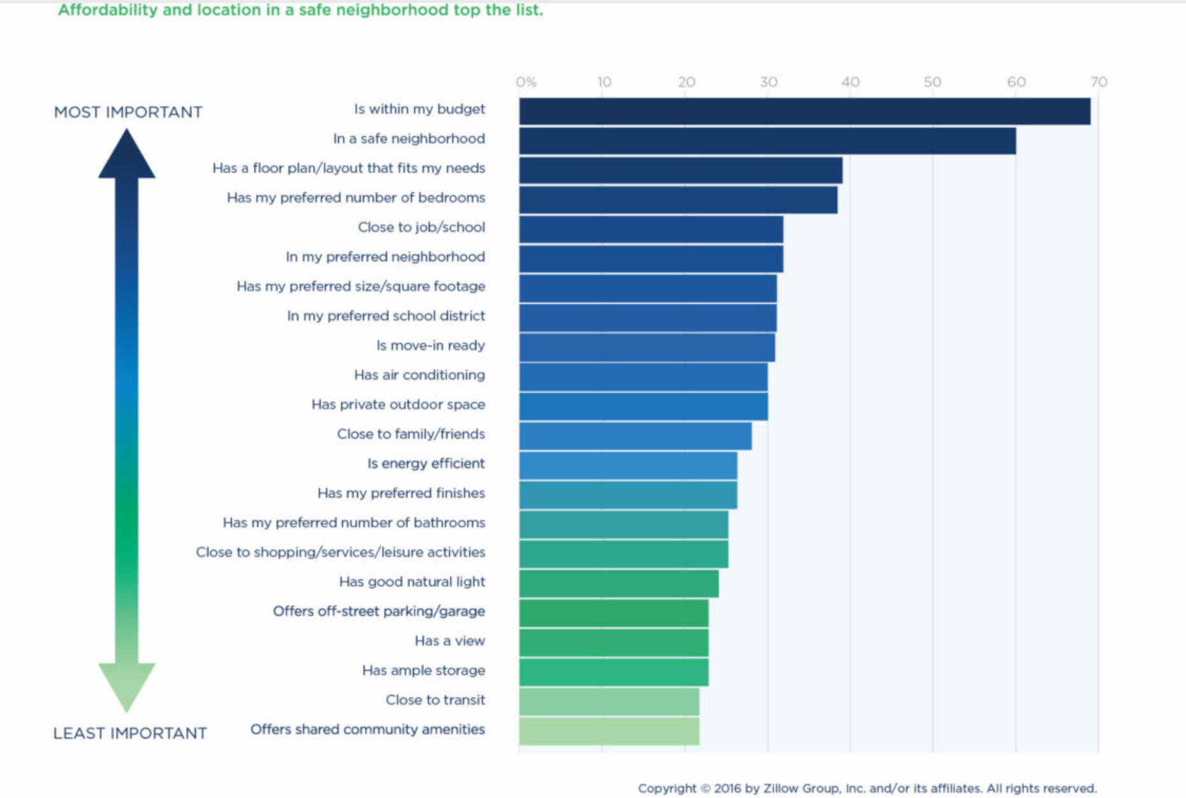

Slide 9
Factors I took into consideration for hypothesis vs the factors from Zillow Analysis
Factors from Hypothesis
Factors from Zillow
Neighborhood
Number of bedrooms, bathrooms and balcony
Total Surface Area
Utilities
Number of floors
Budget
Neighborhood
Floorplan
Preferred number of bedrooms
Close to work

Slide 10
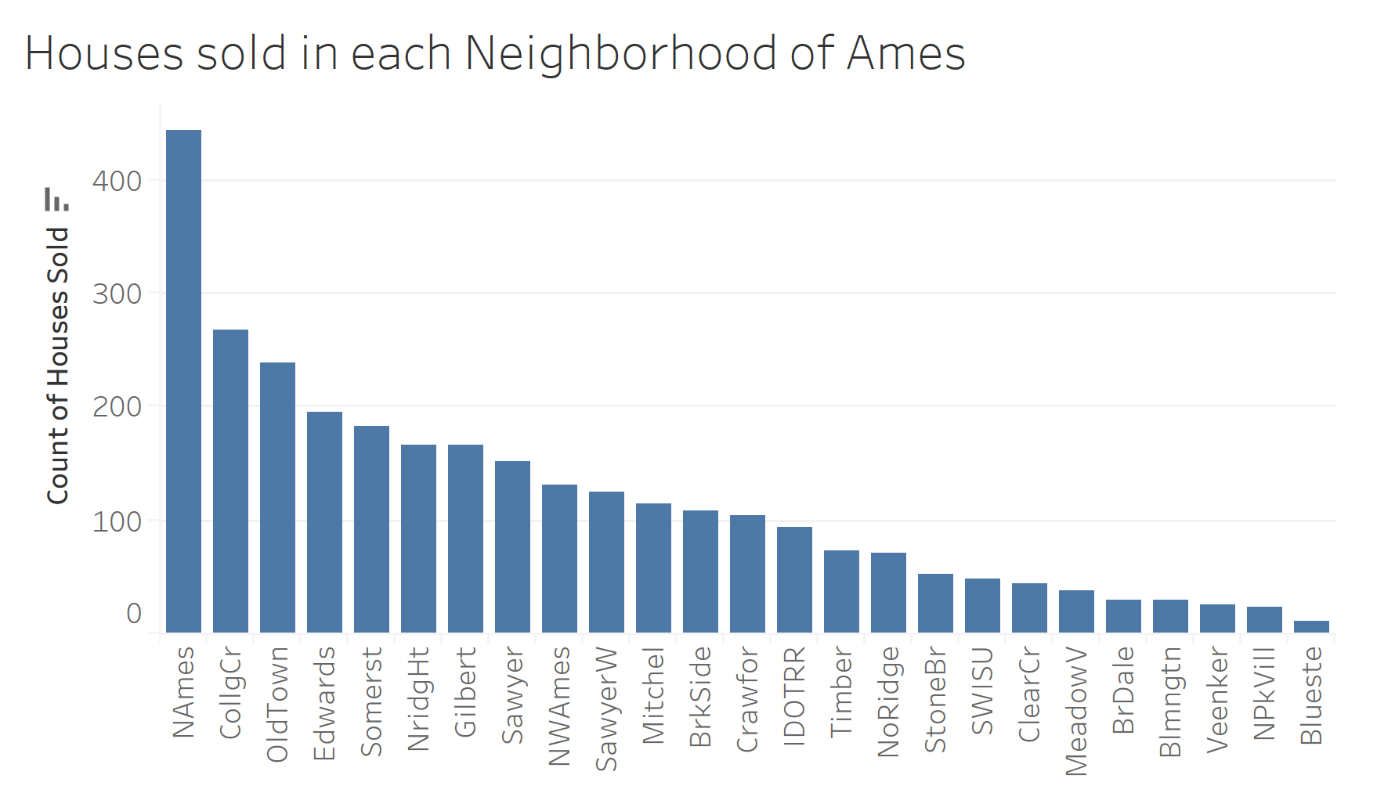
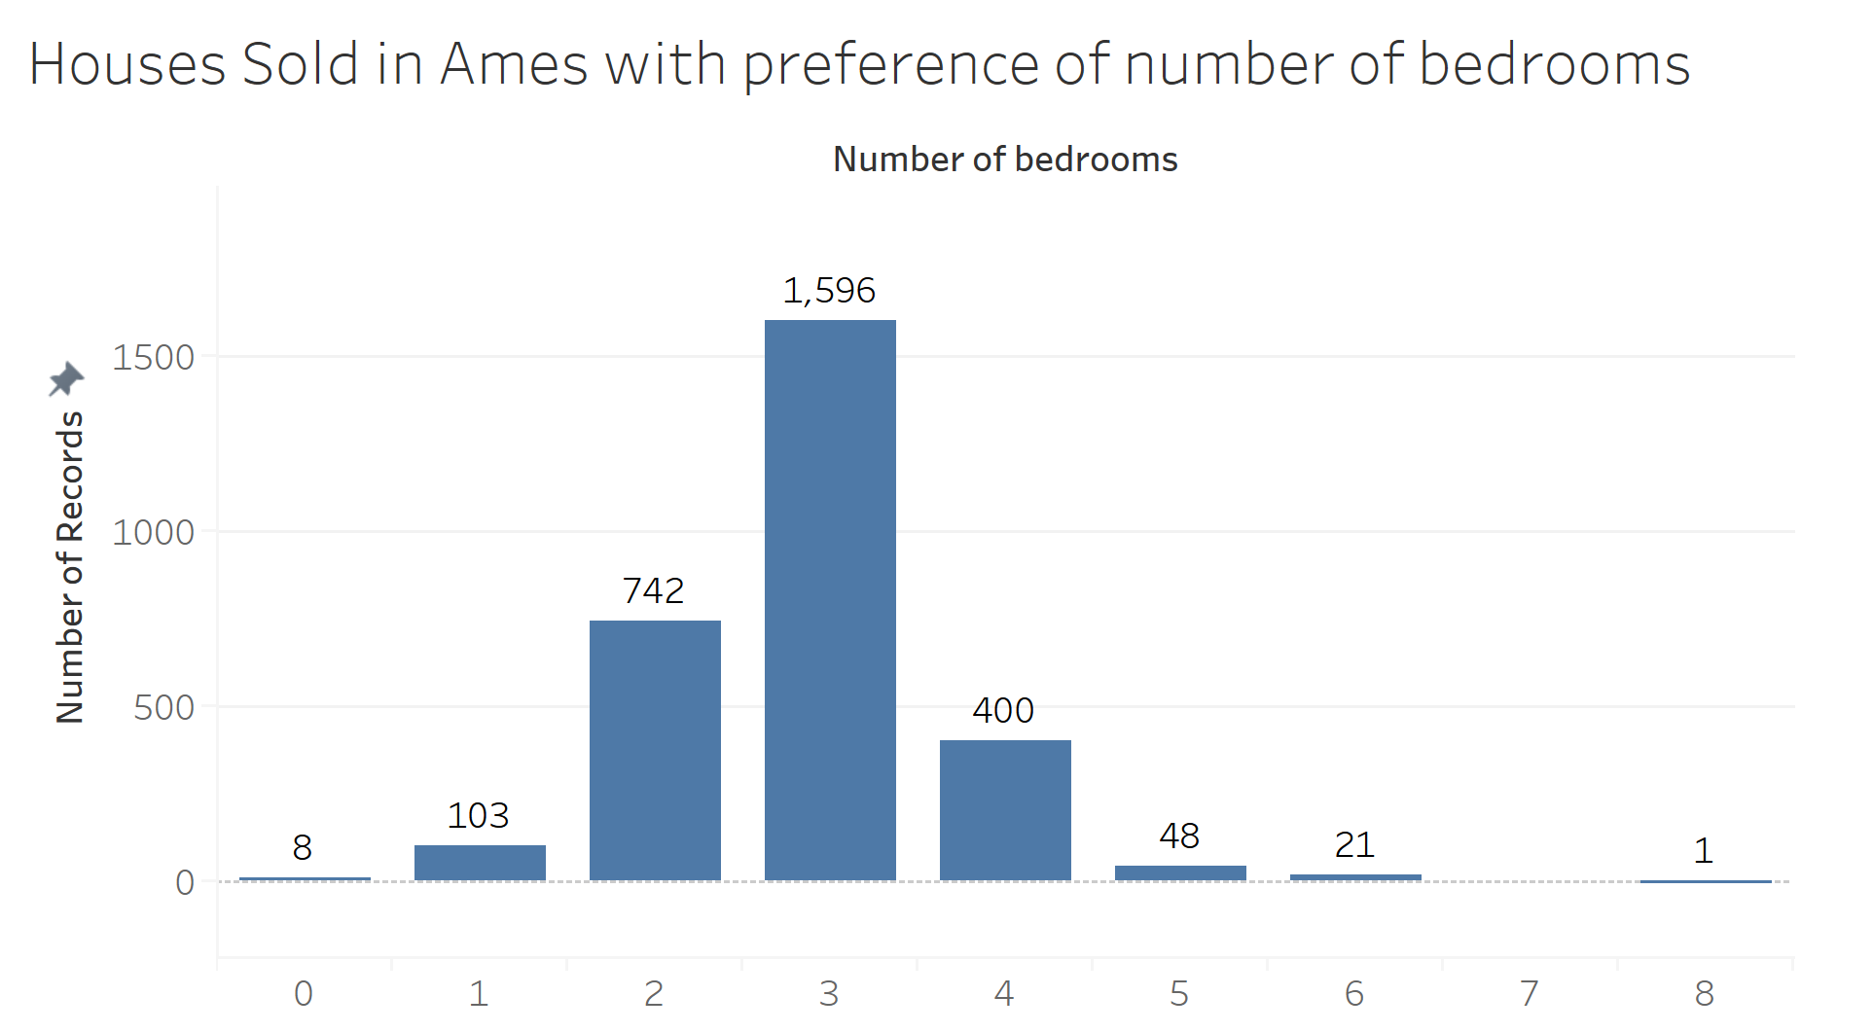
Data insights from the dataset

Slide 11
Observations
People prefer to live in Names neighborhood
We observe that number of bedrooms as zero exist which shows that the data has some outliers, we will work on those outliers in our data pre-processing step.

Slide 12
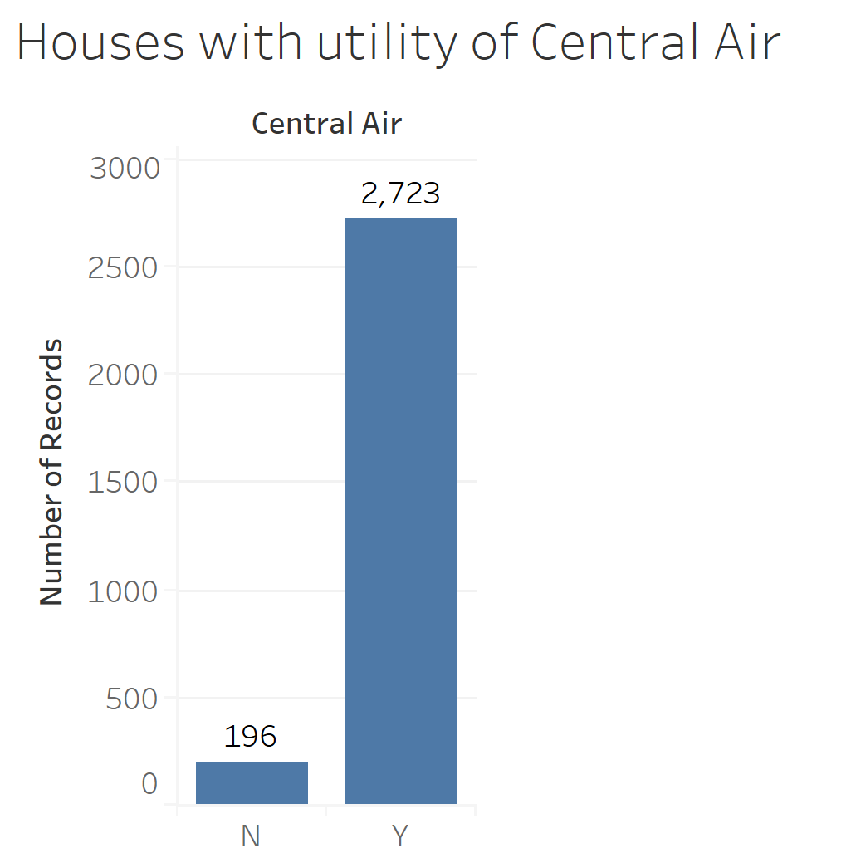
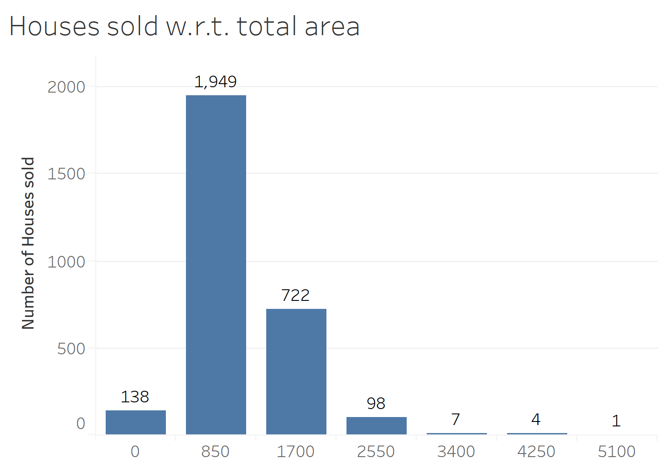
Data insights from the dataset

Slide 13
Observations
People prefer to buy central air homes
I have created bins of size 850 starting from 0 surface area to 5100 surface area. Maximum people preferred a home in a surface area range of 850-1699 followed by 1700-2549

Slide 14
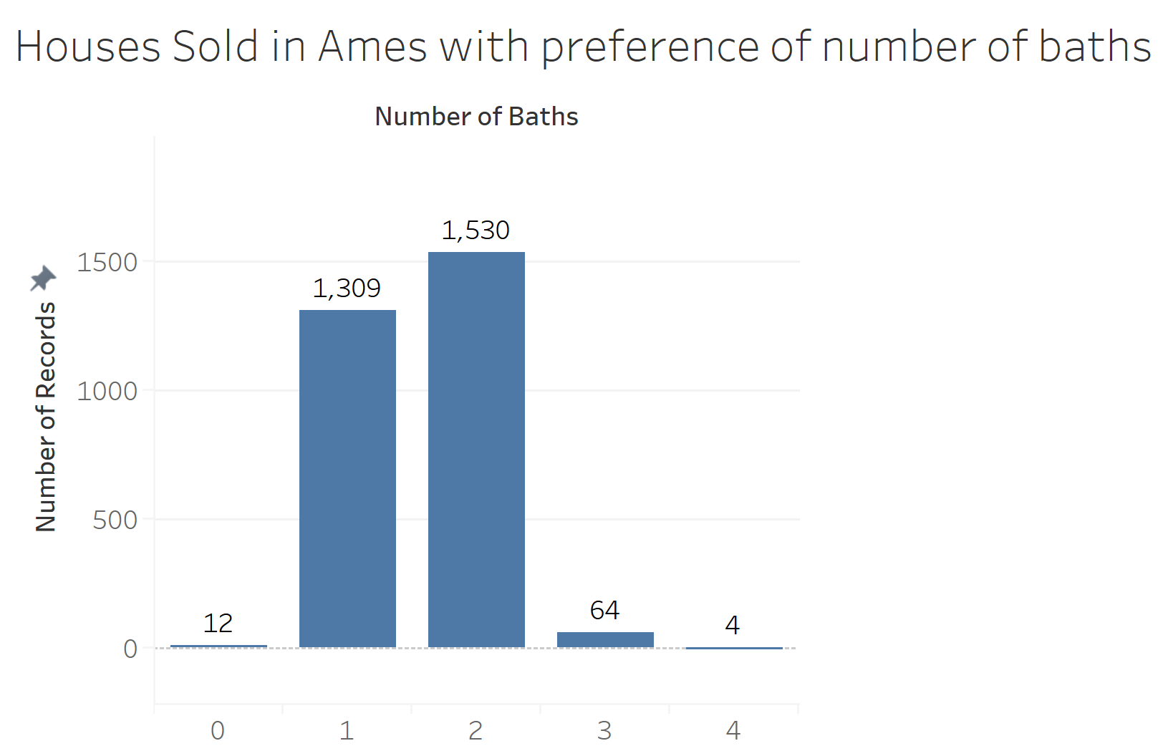
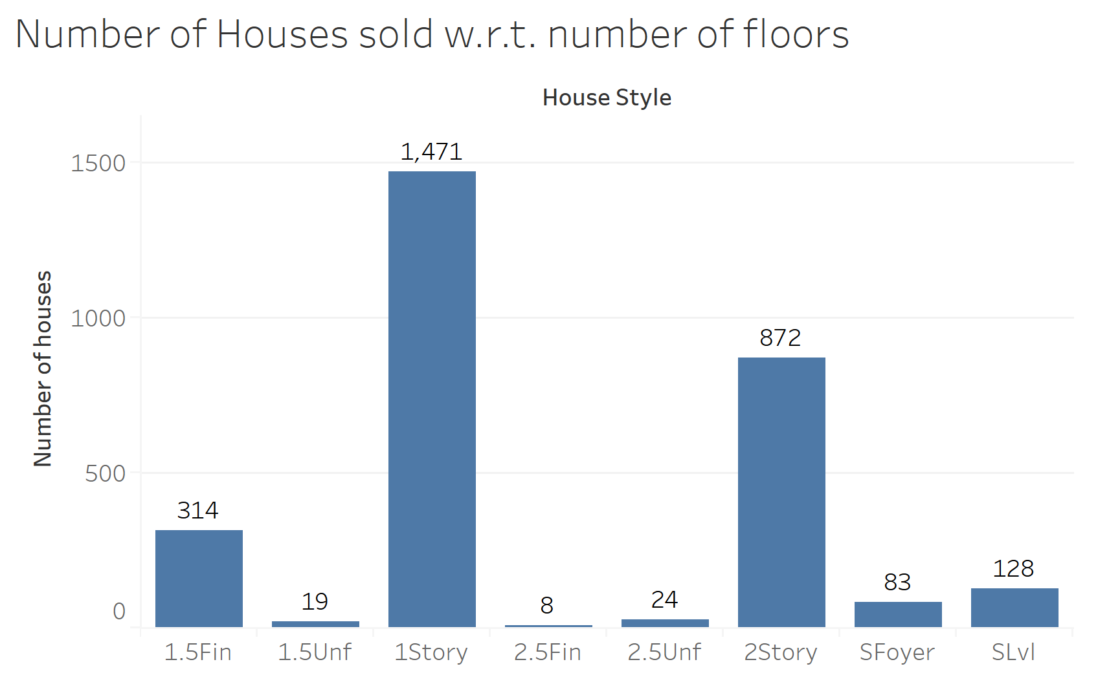
Data insights from the dataset

Slide 15
Observations
We can say there is some error in the data as the number of bathrooms is 0 for 12 houses sold, we will work on this outlier in pre-processing

Slide 16
Type of houses sold Reference: Zillow Analysis 2016

Slide 17
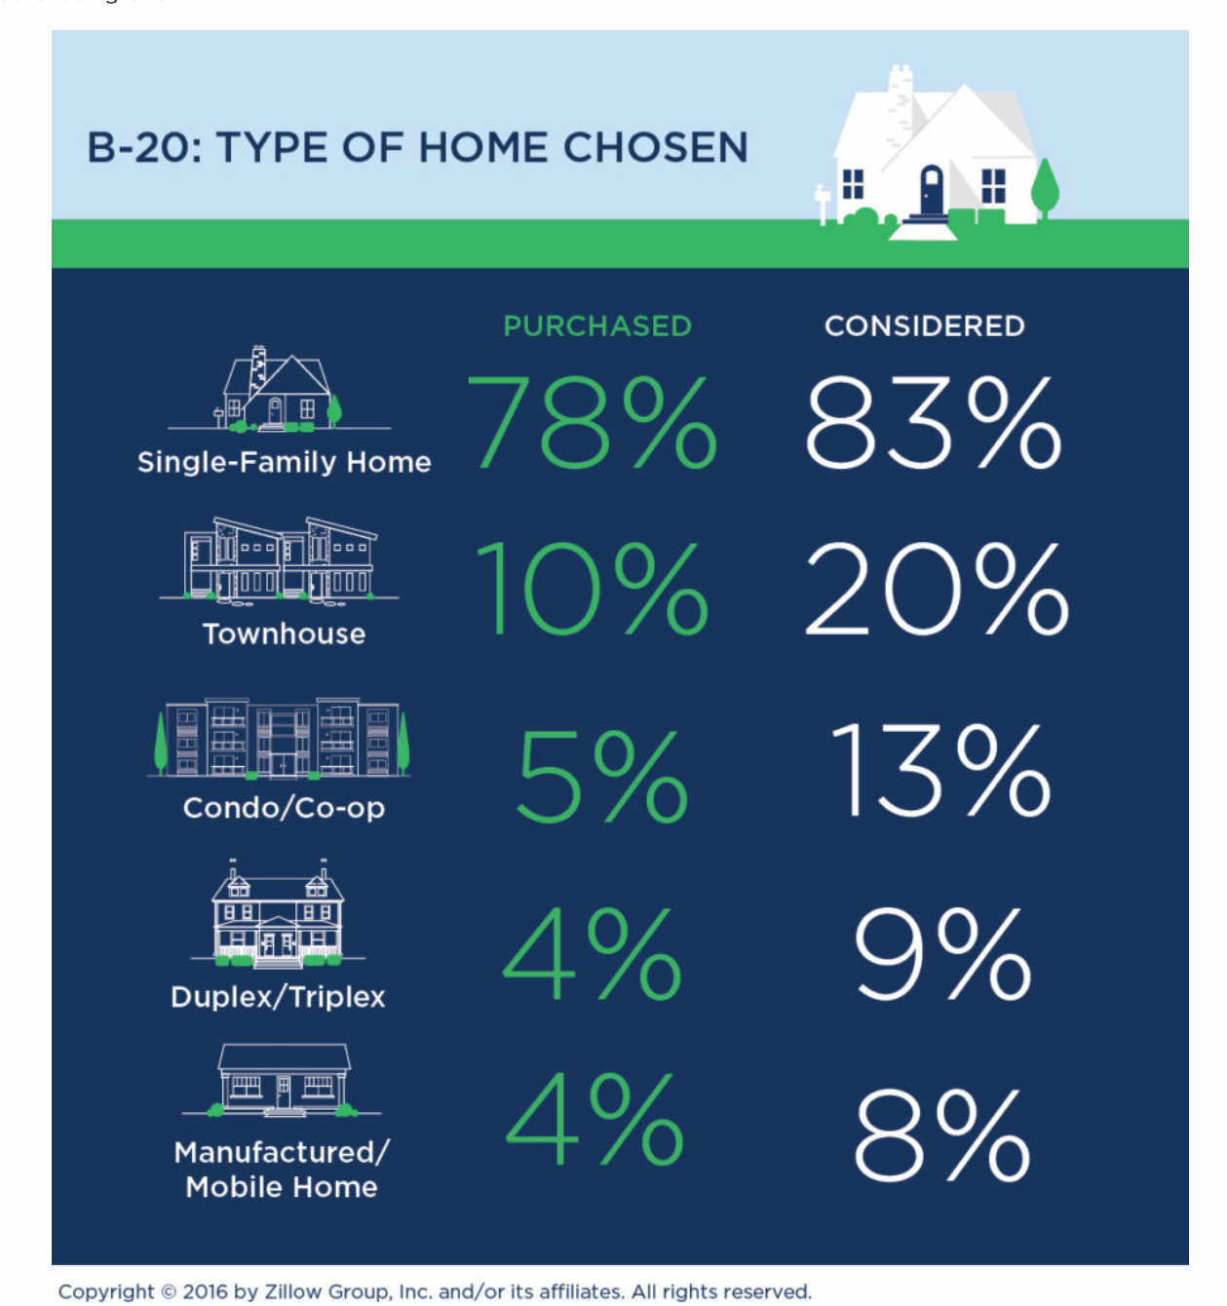

Slide 18
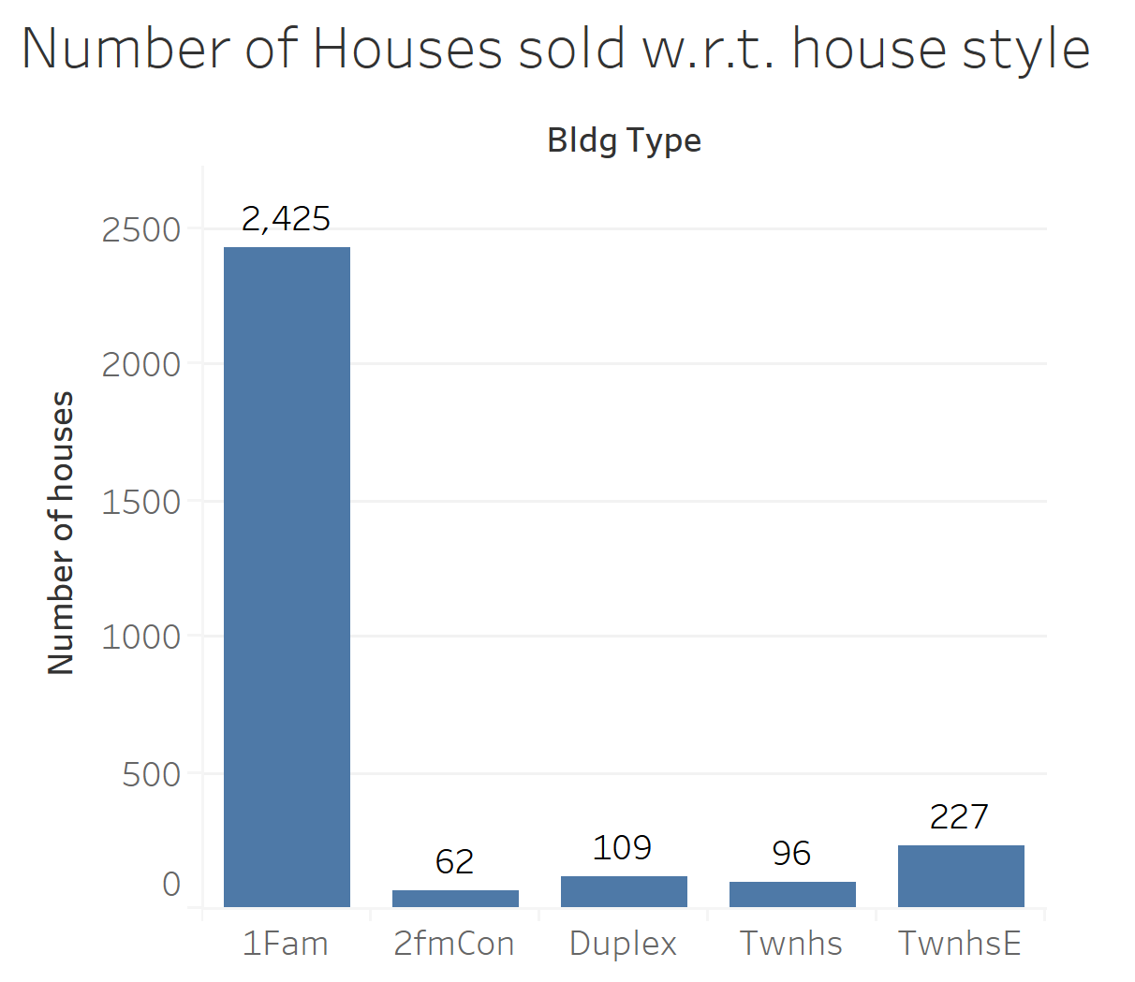
Data insights from the dataset

Slide 19
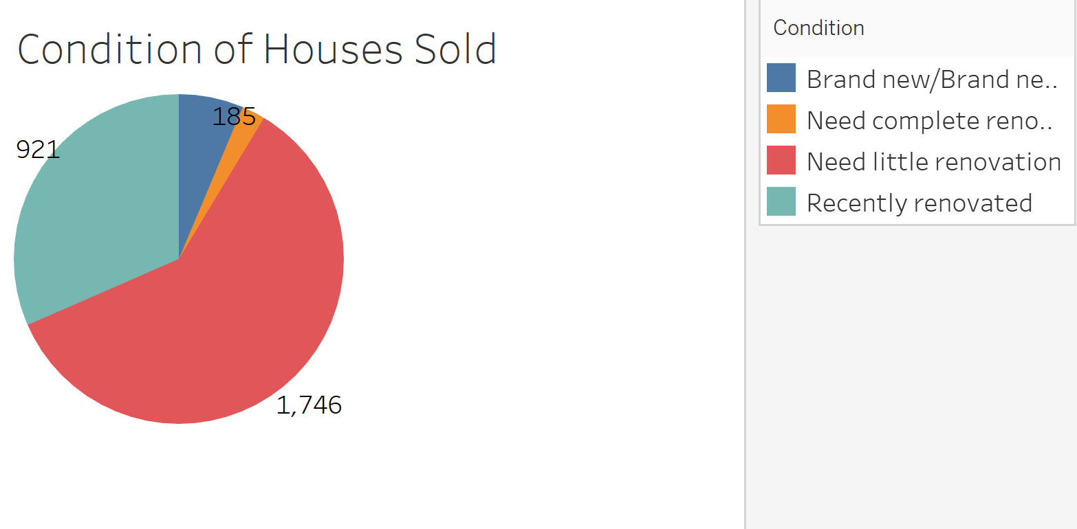

Slide 20
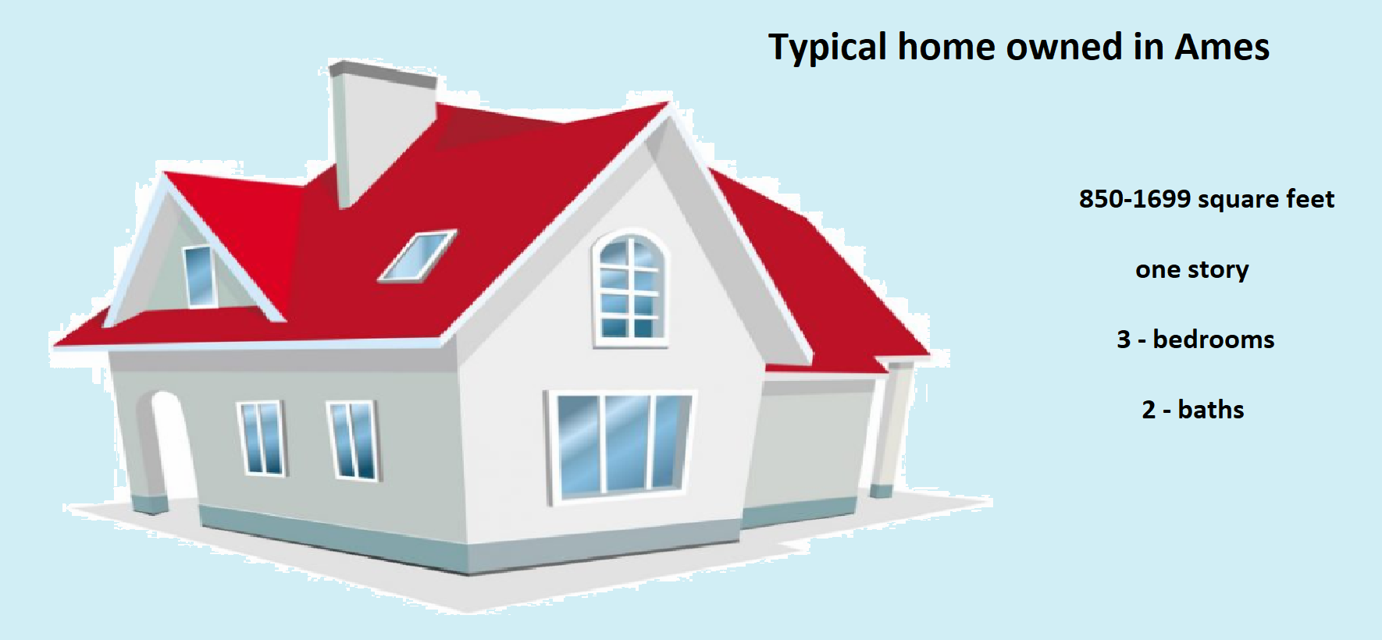

Slide 21
According to Zillow Analysis, Affordability and safe neighborhood are the most important features followed by the preferred floor plan with required total area and number of bedrooms with a central air system.
According to our analysis, we see the neighborhood of NAmes, i.e. North Ames as the most preferred location with maximum number of houses being sold over the period

